Slide 1

Haley- Your Heathcare Assistant
Project Proposal

Slide 2



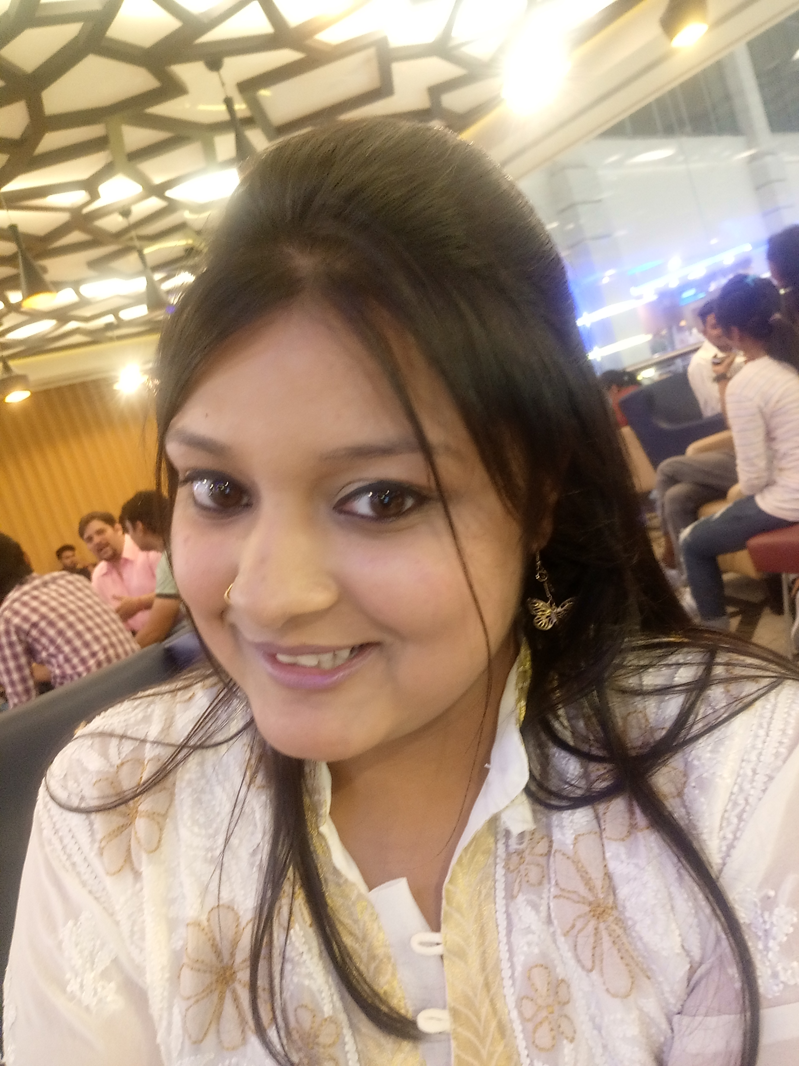

The Team
Avinash Peruboina
D19123919
Ayushi Nayak
D19123831
Hassan Yaqoob
D18130130
Geetika Agarwal
D18128873
Vaibhav Naran Gala
D18130272

Slide 3
Our Vision
Aim to provide a reliable platform for users to track their health on the go.
The users should be able to self diagnose and manage their symptoms until they can get professional heath.
To provide the users a list of doctors whom they can contact if they need to.
Aim to build a community where no one has to worry about being alone in times of need.
‘For a better quality of life’

Slide 4
Introduction
Haley is your personal health assistant designed for comprehensive health monitoring by tracking the most common symptoms.
Haley will ask you a few questions and based on your response, she will help you understand what is the cause of your discomfort.
Haley will also provide a list of doctors to approach based on her initial diagnosis and what home based remedies can be taken in the meanwhile.
Haley is a reliable platform that can be used to track early symptoms and provide data for research.
Haley is also a information source for the general population.

Slide 5
User base
Any person older than 16 can use the web application with ease.
Haley also provides a special feature for parent, they can track the health of their children/ dependents with ease.
‘Easy peezy lemon sqeezy’

Slide 6
The Cause and effect
The proposed project will solve most of the problems that have been identified in the current pandemic.
‘Each one helps one.’

Slide 7
Survey
We created a google survey to know what the users faces in his/her daily life.
The survey had 10 questions
They questions are on the users generic details, the current technologies they use and their thoughts about the change.
The results we got are very motivating.
‘Audience poll…’
https://forms.gle/4a19qDBGTgEyxzJR9

Slide 8


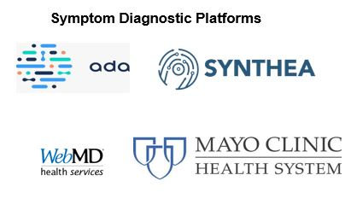
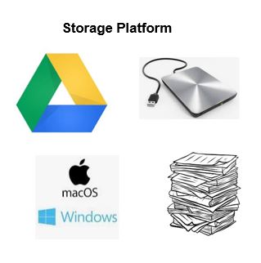

Slide 9
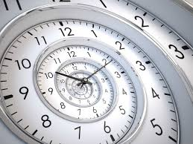
A walk through Time
There are platforms which implements individual features of the application
People have to hunt for the features at different sites and still research it further.
Our project is a one-stop destination for all the features.

Slide 10
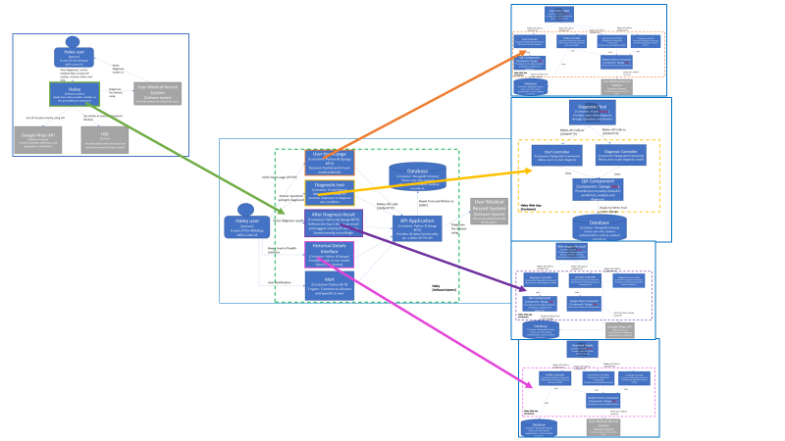
System Architecture
3
1
4
2
5
6
Images displayed in detail at the appendix

Slide 11

Technology Stack
Marvel application
JustInMind prototyping tool
HTML
CSS
Bootstrap
JavaScript/ jQuery
Django
Python
J2EE
MongoDB /MySQL

Slide 12
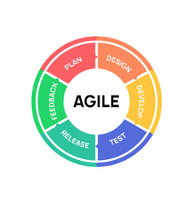
Project Management
Using the agile methodology
Maintain a burn down chart to track the progress.
Divided the project into 5 phases
Using GitHub to store and deploy the project
Using Kanban board to track the user stories and actors

Slide 13
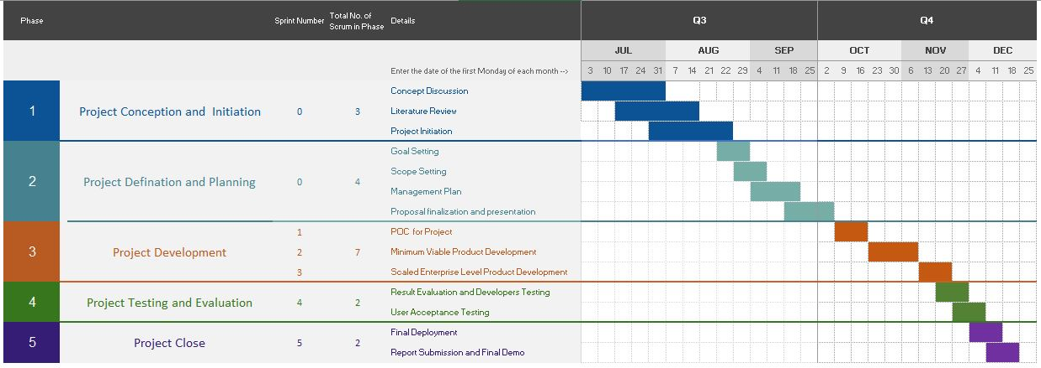
Timelines

Slide 14
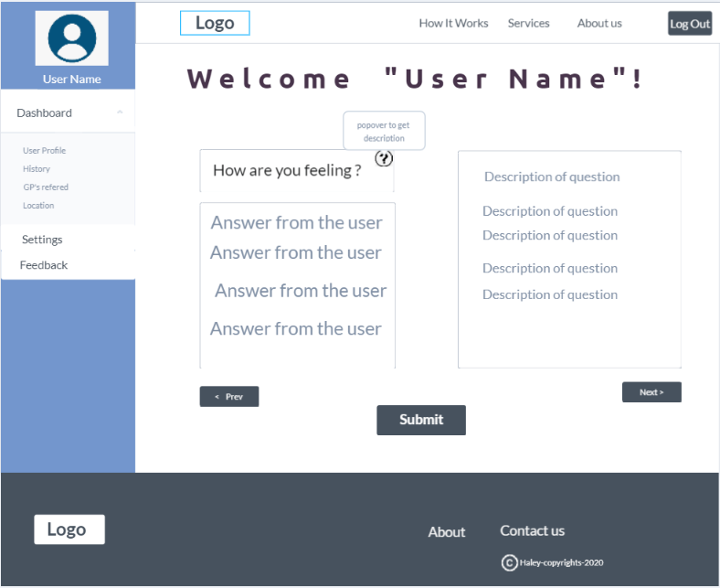
Initial Template

Slide 15
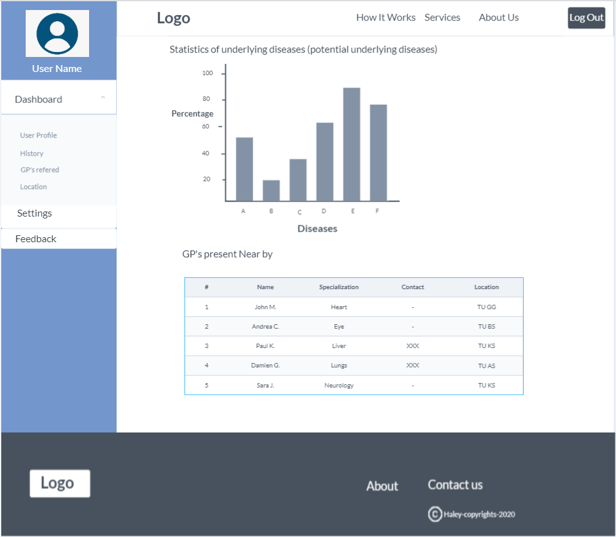

Slide 16
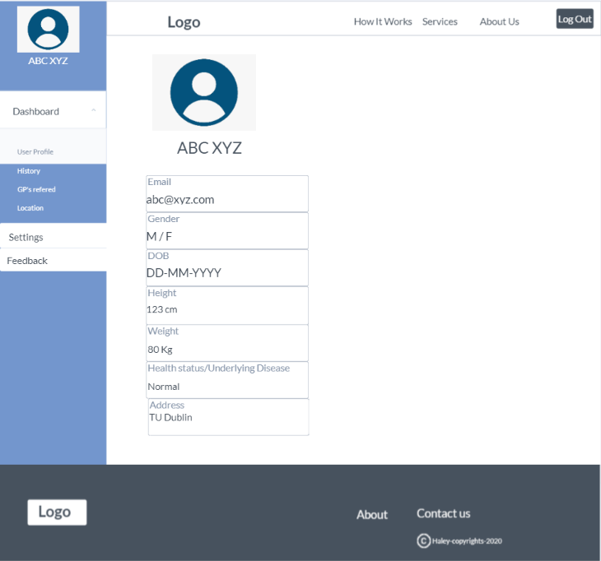

Slide 17
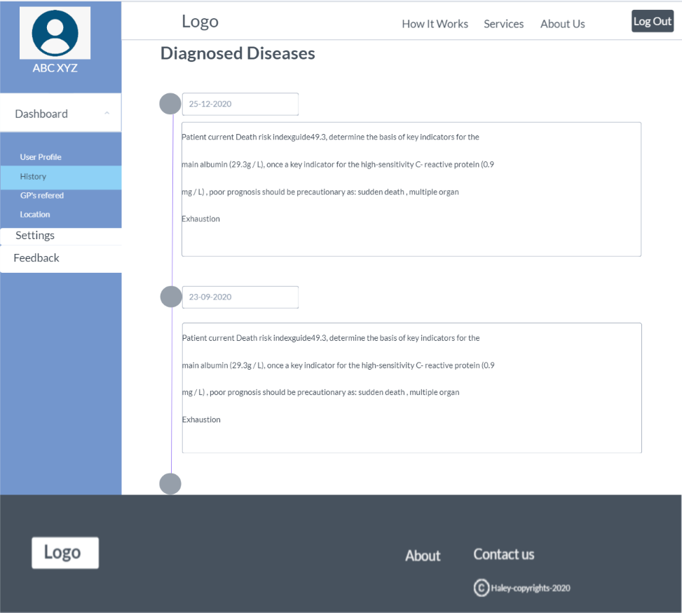

Slide 18
Data Description
Due to the scope of the project we were not able to find a dataset large enough to meet the requirements
What We did?
Found datasets from online repository (Kaggle, UCI , Github and Socrates)^{1,2,3}
Created data synthetically to scale up the number of rows by randomly assigning weights
Files found were in format of CSV and JSON
We merged the files (from Kaggle and synthetic data generated) to meet the required attributes of weights, multiple symptoms, target diseases and number of rows.
Finally dataset generated has total number of 10001 rows and 49 attributes making it to total of 490049 pieces of data.
Attribute description, Columns 1 – 48: Numeric
Target Variable: Categorical

Slide 19
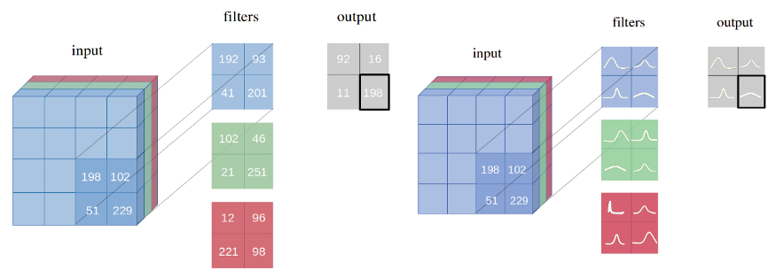
Proposed Model
Network with point-estimates as weights vs Network with probability distribution as weights. https://arxiv.org/pdf/1806.05978.pdf
Notes:
In short, the answer is: a measure of uncertainty in the prediction is missing from the current neural networks architectures, but Bayesian neural networks incorporate this.

Slide 20
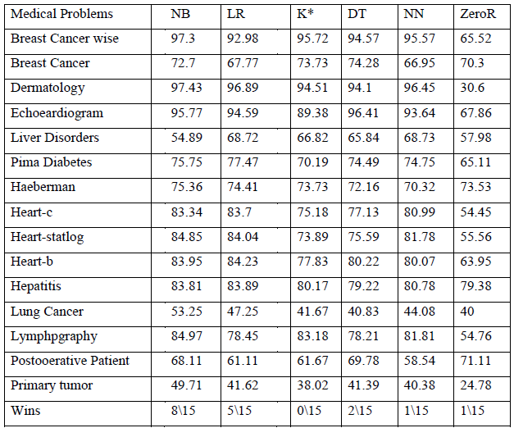
Comparison of different Classifiers
Predictive Accuracy of Bayes and other Technique (Al-Aidaroos, Bakar, & Othman, 2012)
Notes:
As we can see even the simple bayes classifier performs better than decision tree, k star, linear regression models. Thus giving an upper hand for our proposed model and can be used easily.

Slide 21

Evaluation
Space complexity- Measure the bulkiness of the code
Time Complexity- Measures the time taken to populate the pages and results.
Confusion Matrix- Calculating the error rate and false positives.
User Feedback- Use the feedback to improve the performance of our app.

Slide 22
References
Al-Aidaroos, K., Bakar, A., & Othman, Z. (2012). Medical Data Classification With Naive Bayes Approach. Information Technology Journal .
https://arxiv.org/pdf/1806.05978.pdf
https://medium.com/neuralspace/bayesian-neural-network-series-post-1-need-for-bayesian-networks-e209e66b70b2
https://github.com/adalca/medical-datasets
https://www.kaggle.com/itachi9604/disease-symptom-description-dataset
https://hpo.jax.org/app/download/annotation
https://github.com/leanderme/sytora
https://www.kaggle.com/plarmuseau/sdsort/home
https://www.kaggle.com/plarmuseau/primer
https://www.kaggle.com/plarmuseau/symptom-disease-recommender

Slide 23
https://github.com/Aniruddha-Tapas/Predicting-Diseases-From-Symptoms
https://themanifest.com/mobile-apps/how-develop-healthcare-app
https://www.malacards.org/
https://www.kaggle.com/moradnejad/nhanes-questionnaires-datasets-20172018-csv?
https://www.kaggle.com/johnsmith88/heart-disease-dataset
https://www.kaggle.com/mansoordaku/ckdisease https://www.kaggle.com/priya1207/diseases-dataset
http://ecg.mit.edu/time-series/
https://archive.ics.uci.edu/ml/datasets/Statlog+%28Heart%29
https://physionet.org/data/
https://ada.com/
https://github.com/GroupProjectSem3/synthea

Slide 24
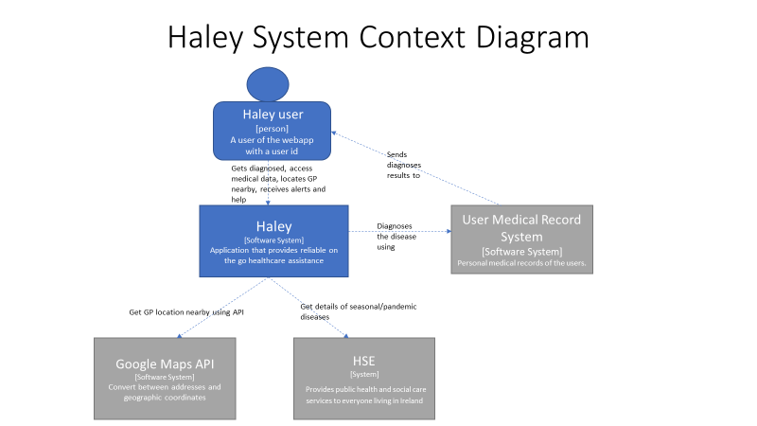
Appendix
1

Slide 25
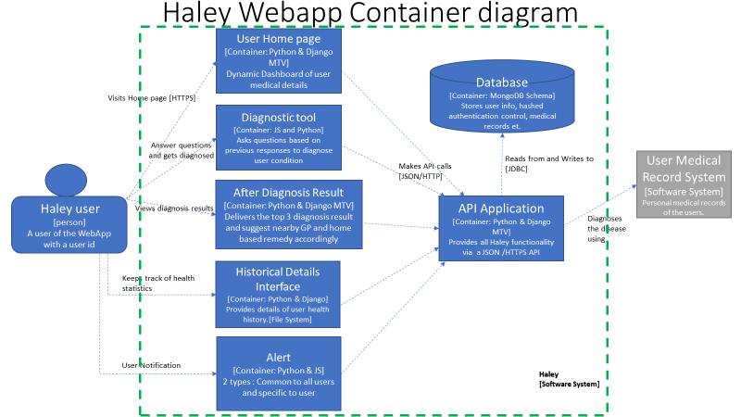
2

Slide 26
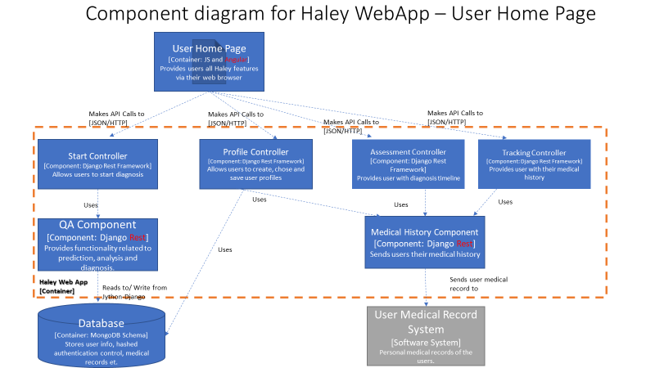
3

Slide 27
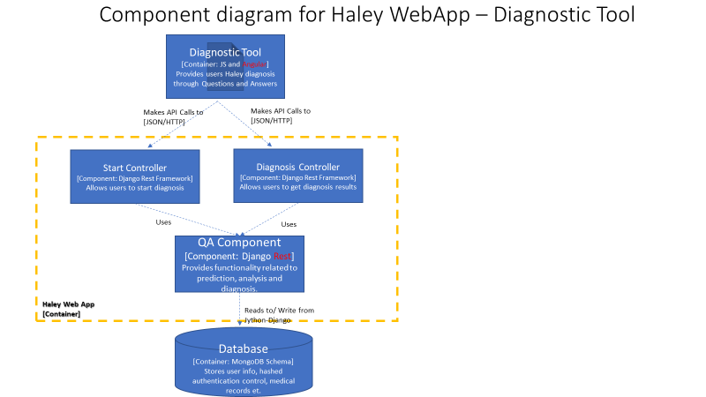
4

Slide 28
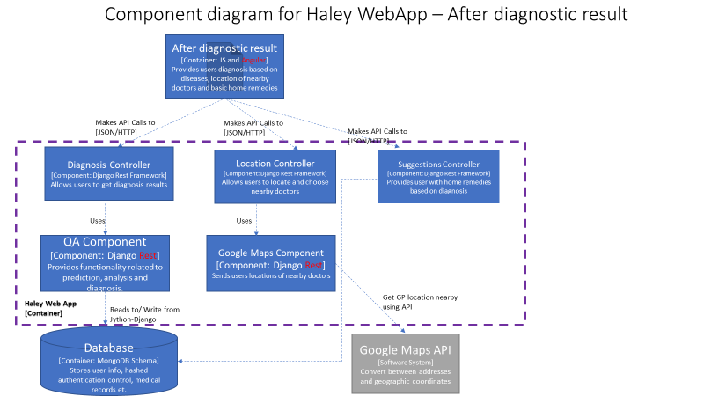
5

Slide 29
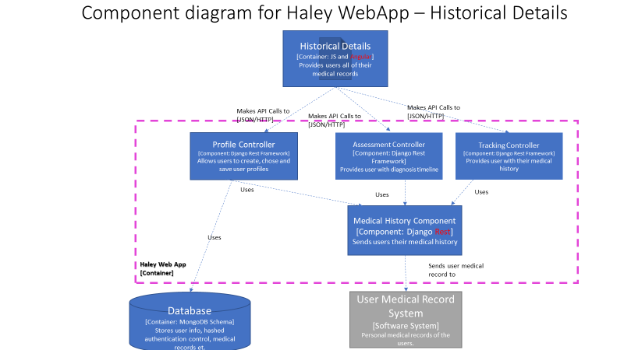
6

